Slide 1



Test
View in Power BI
Last data refresh:
28/03/2024 08:12:04 UTC
Downloaded at:
28/03/2024 09:22:40 UTC

Slide 2
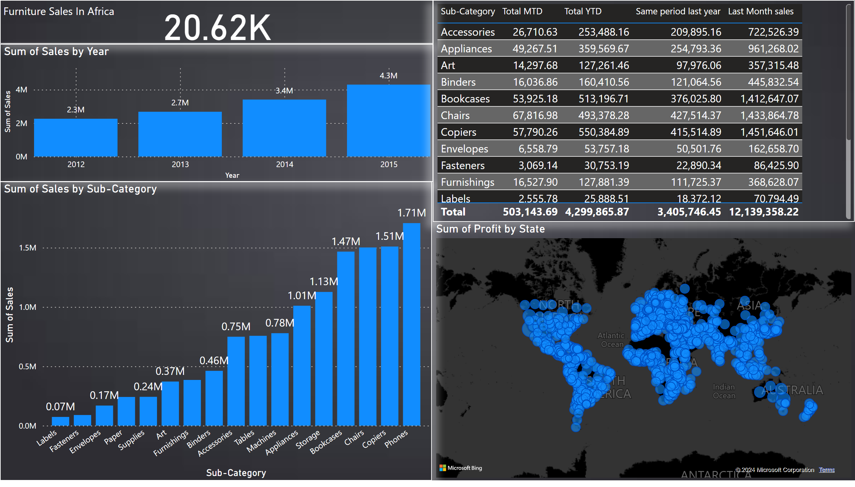
Dashboard
Notes:
clusteredColumnChart
No alt text provided
map
No alt text provided
clusteredColumnChart
No alt text provided
tableEx
No alt text provided
card
No alt text provided
textbox
No alt text provided

Slide 3
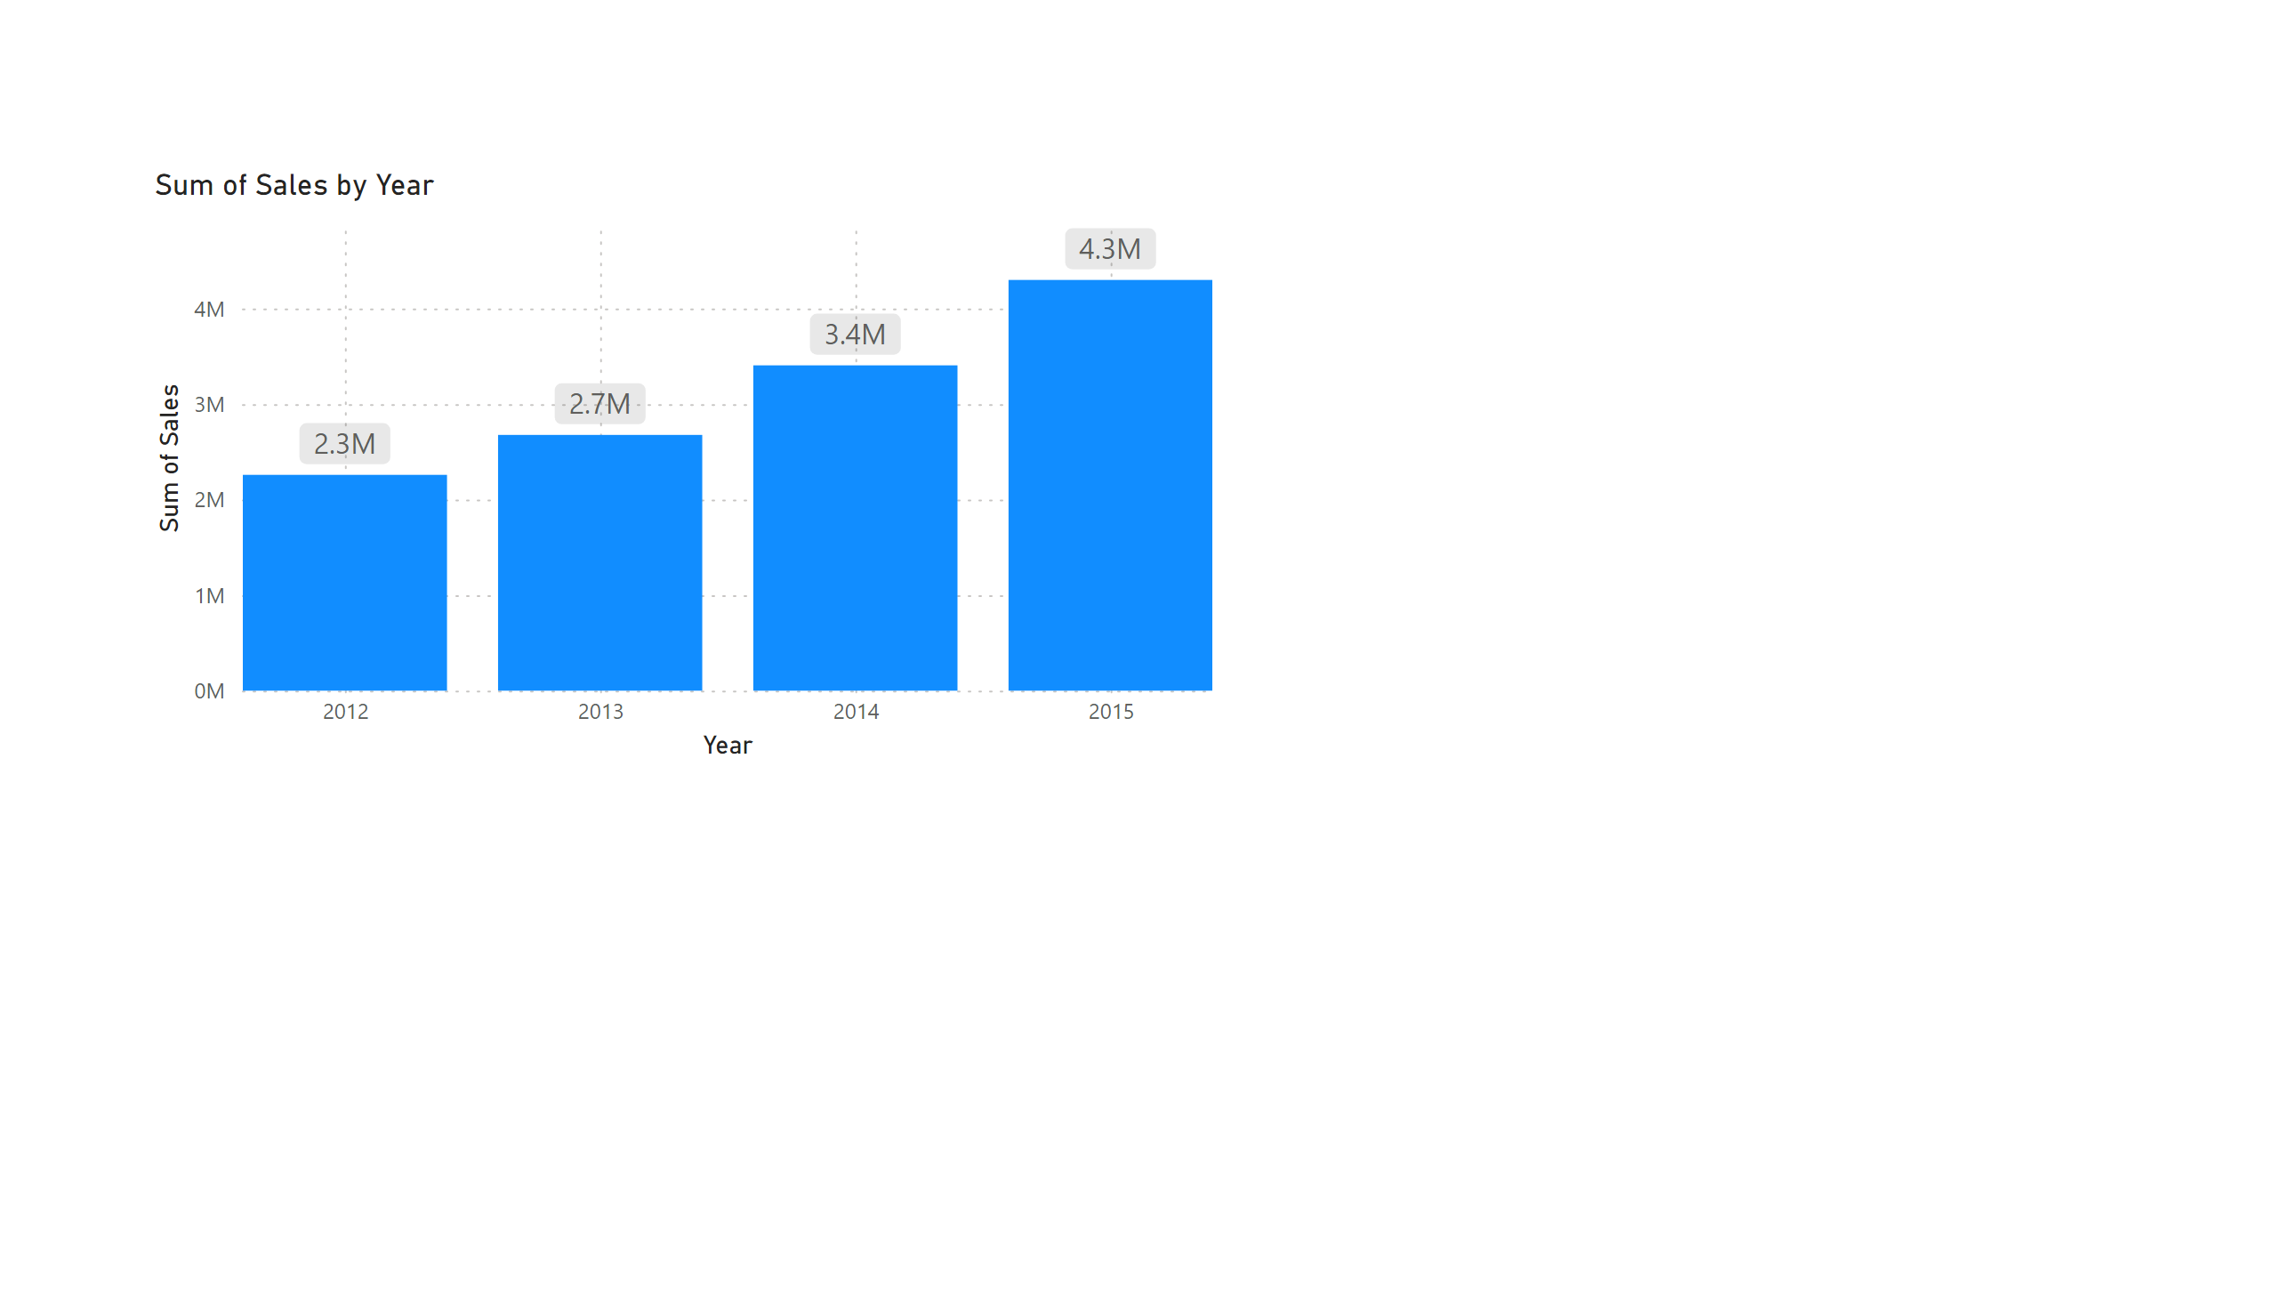
Sum of sales by Year
Notes:
clusteredColumnChart
No alt text provided

Slide 4
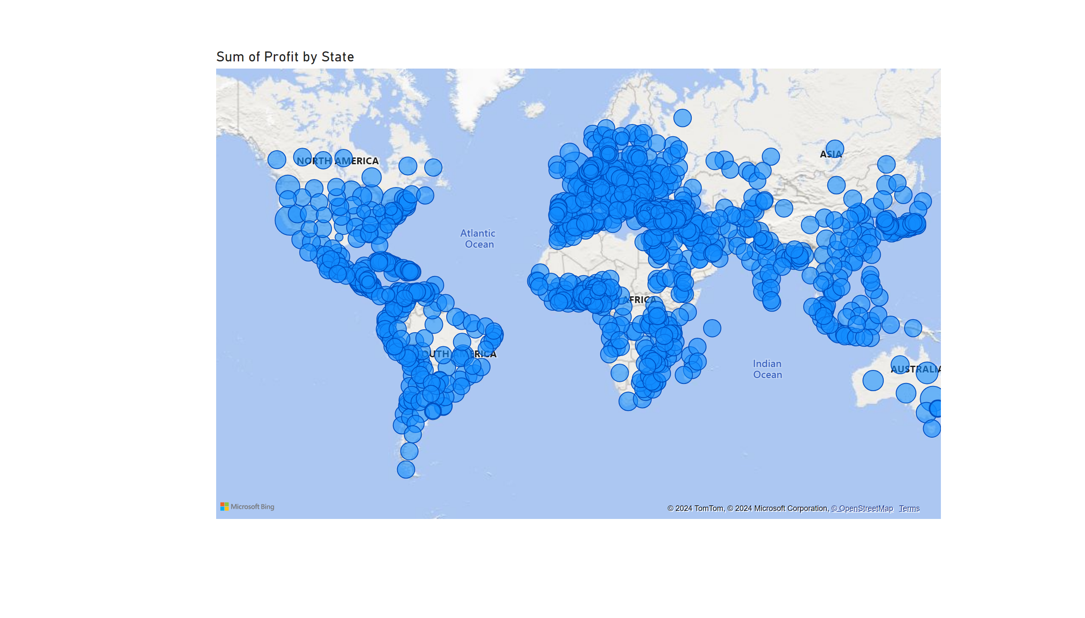
Profit By States
Notes:
map
No alt text provided

Slide 5
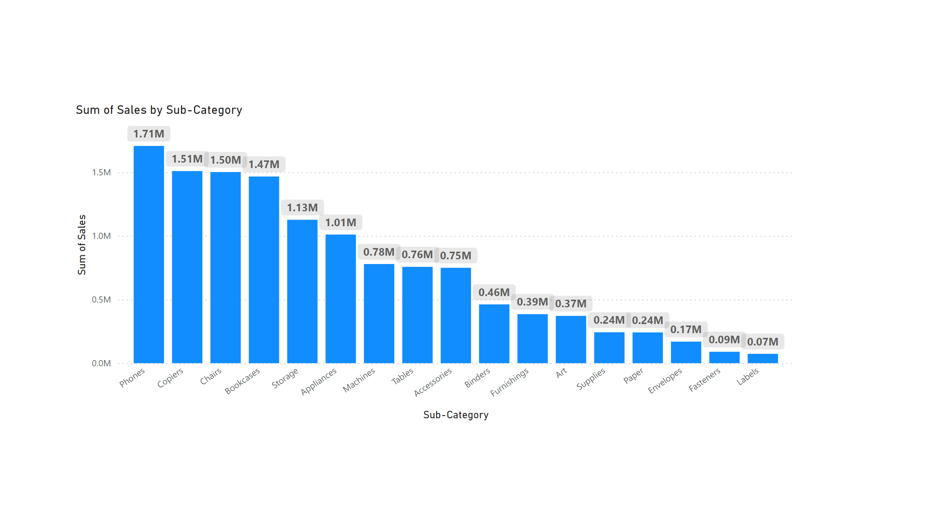
Sales per Category
Notes:
clusteredColumnChart
No alt text provided

Slide 6
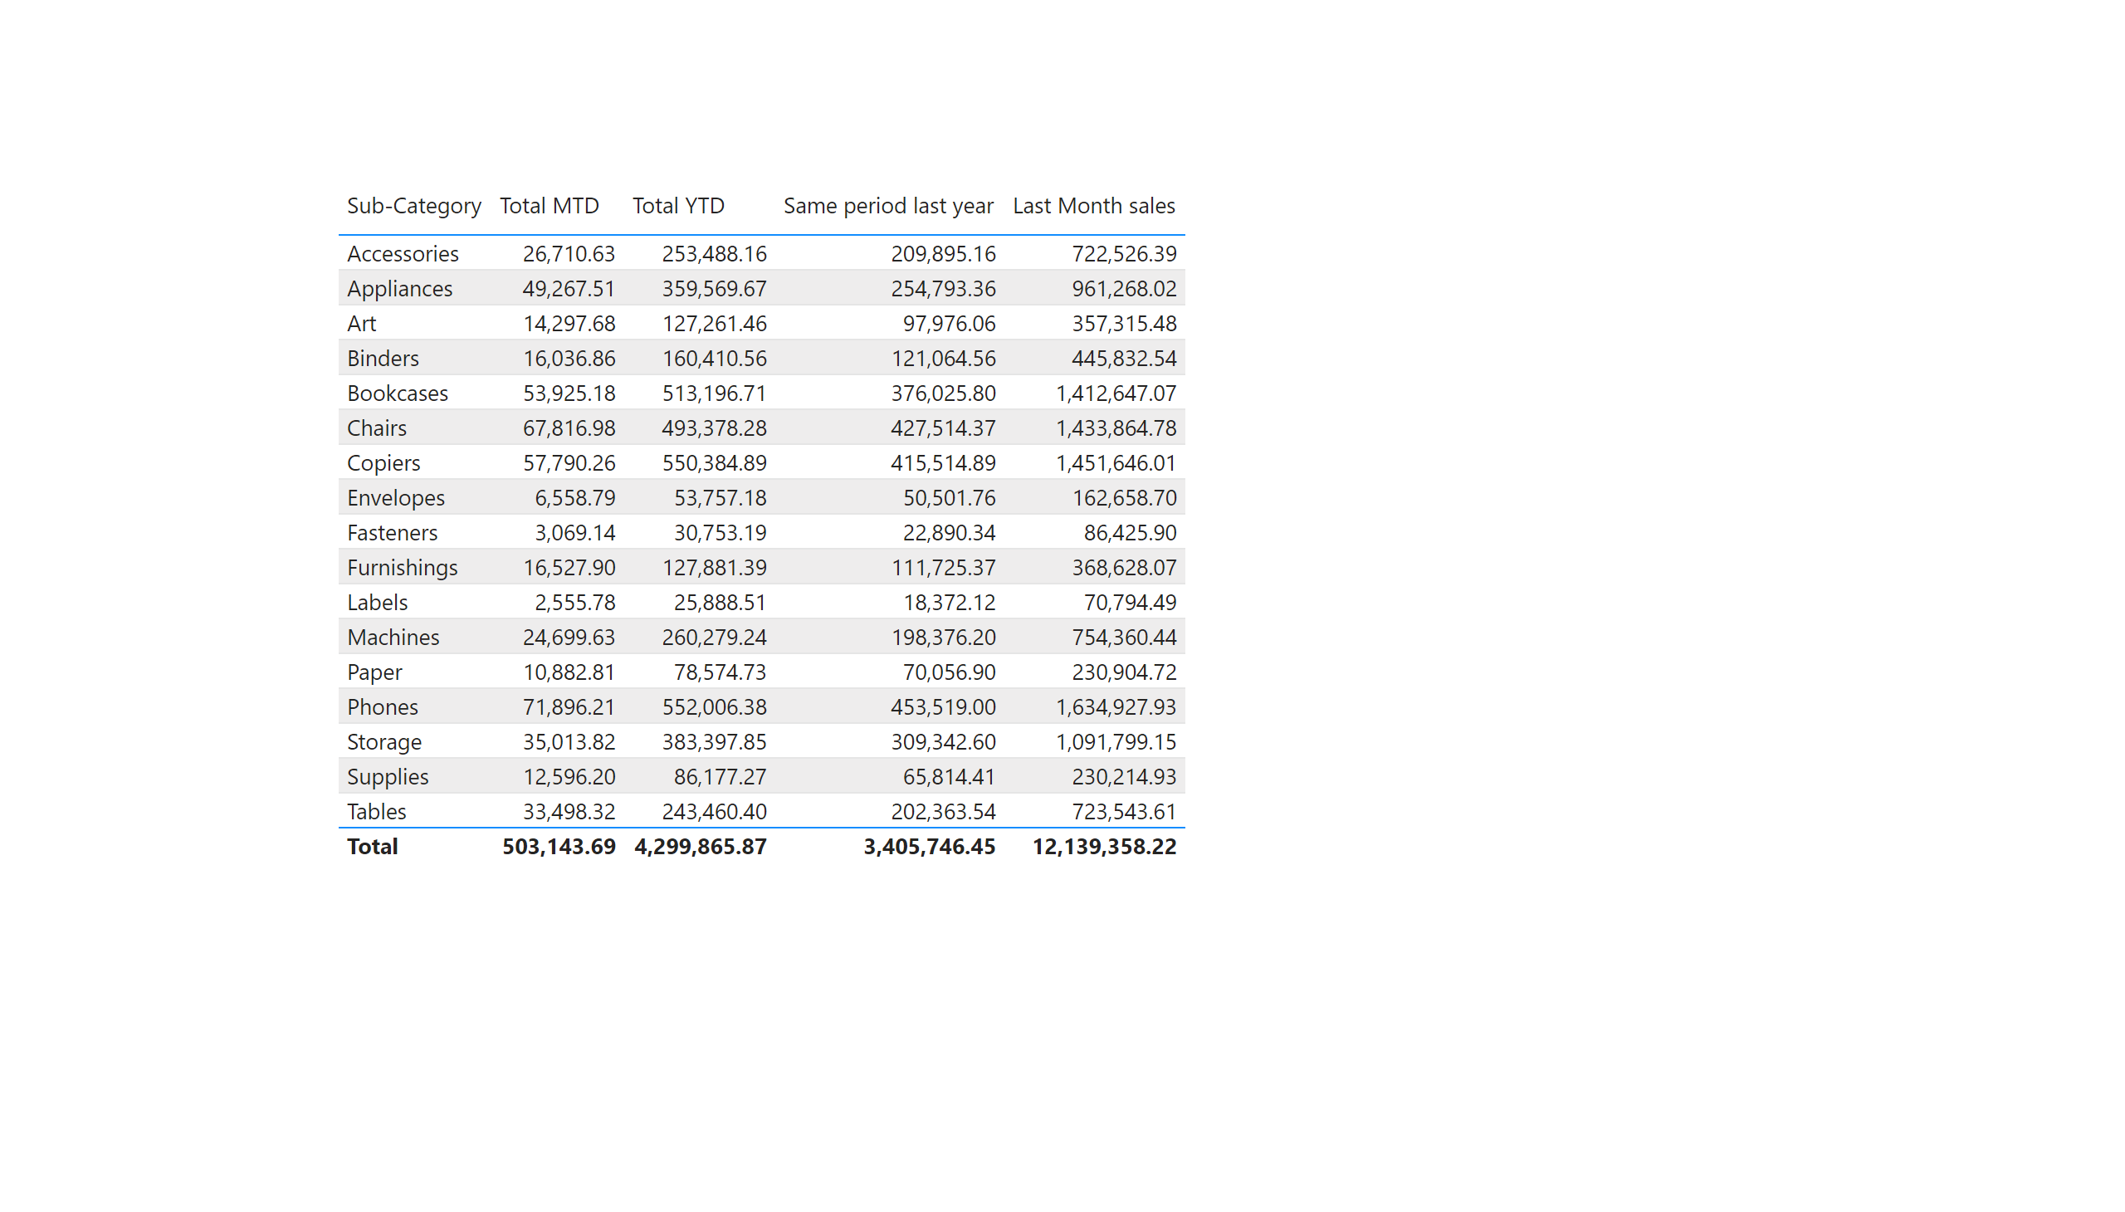
MTD QTD
Notes:
tableEx
No alt text provided

Slide 7
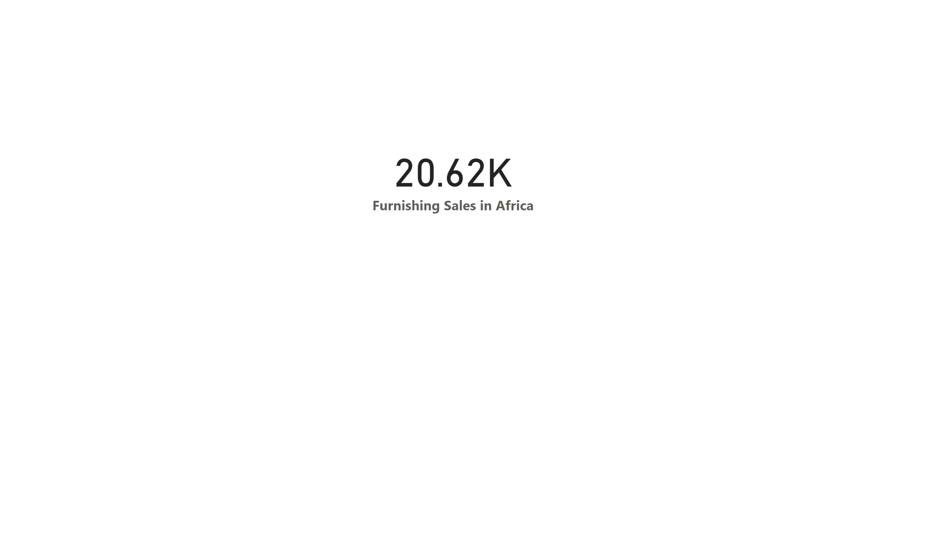
Furniture Sales in Africa
Notes:
card
No alt text provided

